Slide 1
Toby Simmerling
Development Manager

Slide 2
Experienced Coder 20 years experience .Net 2.1 to Core JQuery to Angular | Practical and Pragmatic Aim for Perfection but never let it get in the way of progress Why say 100 words if 10 will do
Achiever not Dreamer Proven history of turning ideas into realistic goals and delivering on expectations | Composure Stop look and listen Ability to see the solution
Leader Running teams of developers Influencing practices Changing perceptions of done | Buffer/Barrier/Conduit Primary Goal Keep the Coders Coding Main aim of a development manager is to ensure that the team can work to the best of there ability

Slide 3
First Job
Principle witness in high court
Over charged MD £35,000 (twice)
Athlete
Marathon Running
Triathlete
Contractor
Good Working Practices
Bad Working Practices
Great Managers
Poor Managers
Family
Children Teach Compromise
Cancer Teaches Perseverance
Perfect Job
Boredom
More to Achieve

Slide 4
First Job
Principle witness in high court
Over charged MD £35,000 (twice)
Perfect Job
Boredom
More to Achieve
Athlete
Marathon Running
Triathlete
Contractor
Good Working Practices
Bad Working Practices
Great Managers
Poor Managers
Family
Children Teach Compromise
Cancer Teaches Perseverance

Slide 5
Notable Experiences
First Job
Principle analyst in high court case
Over charged MD £35,000 (twice)
Perfect Job
Boredom
More to Achieve
Athlete
Marathons
Triathlons
Contractor
Good Working Practices
Bad Working Practices
Great Managers
Poor Managers
Family
Children Teach Compromise
Cancer Teaches Perseverance

Slide 6
Experience
First Job
Perfect Job
Athlete
Contractor
Family
Development Manager

Slide 7
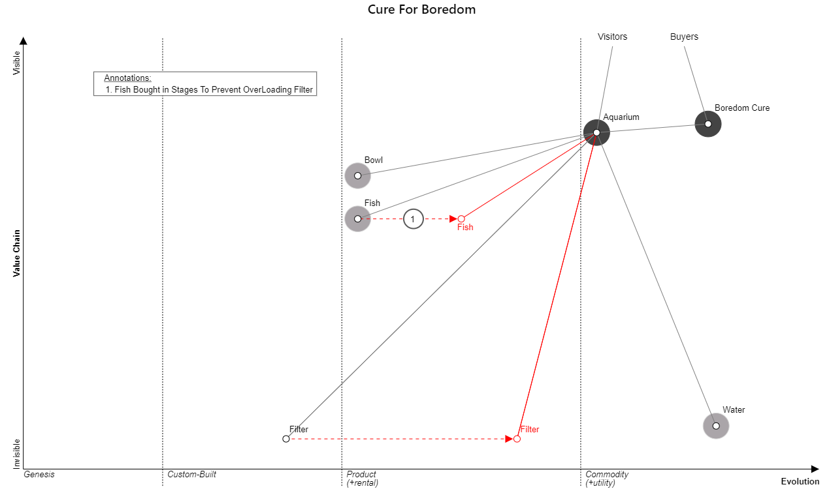
Example Wardley Map

Slide 8
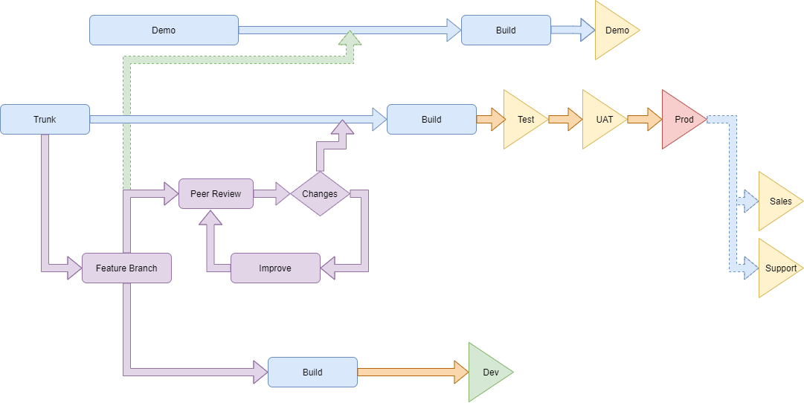
Optimal CI/CD Flow

Slide 9
Toby Simmerling
Development Manager
tobysimmerling@gmail.com
07968 040 980

